Slide 1
C. difficile Detection and the Importance of Proper Specimen Collection and Testing
[Name]
[Title]

Slide 2
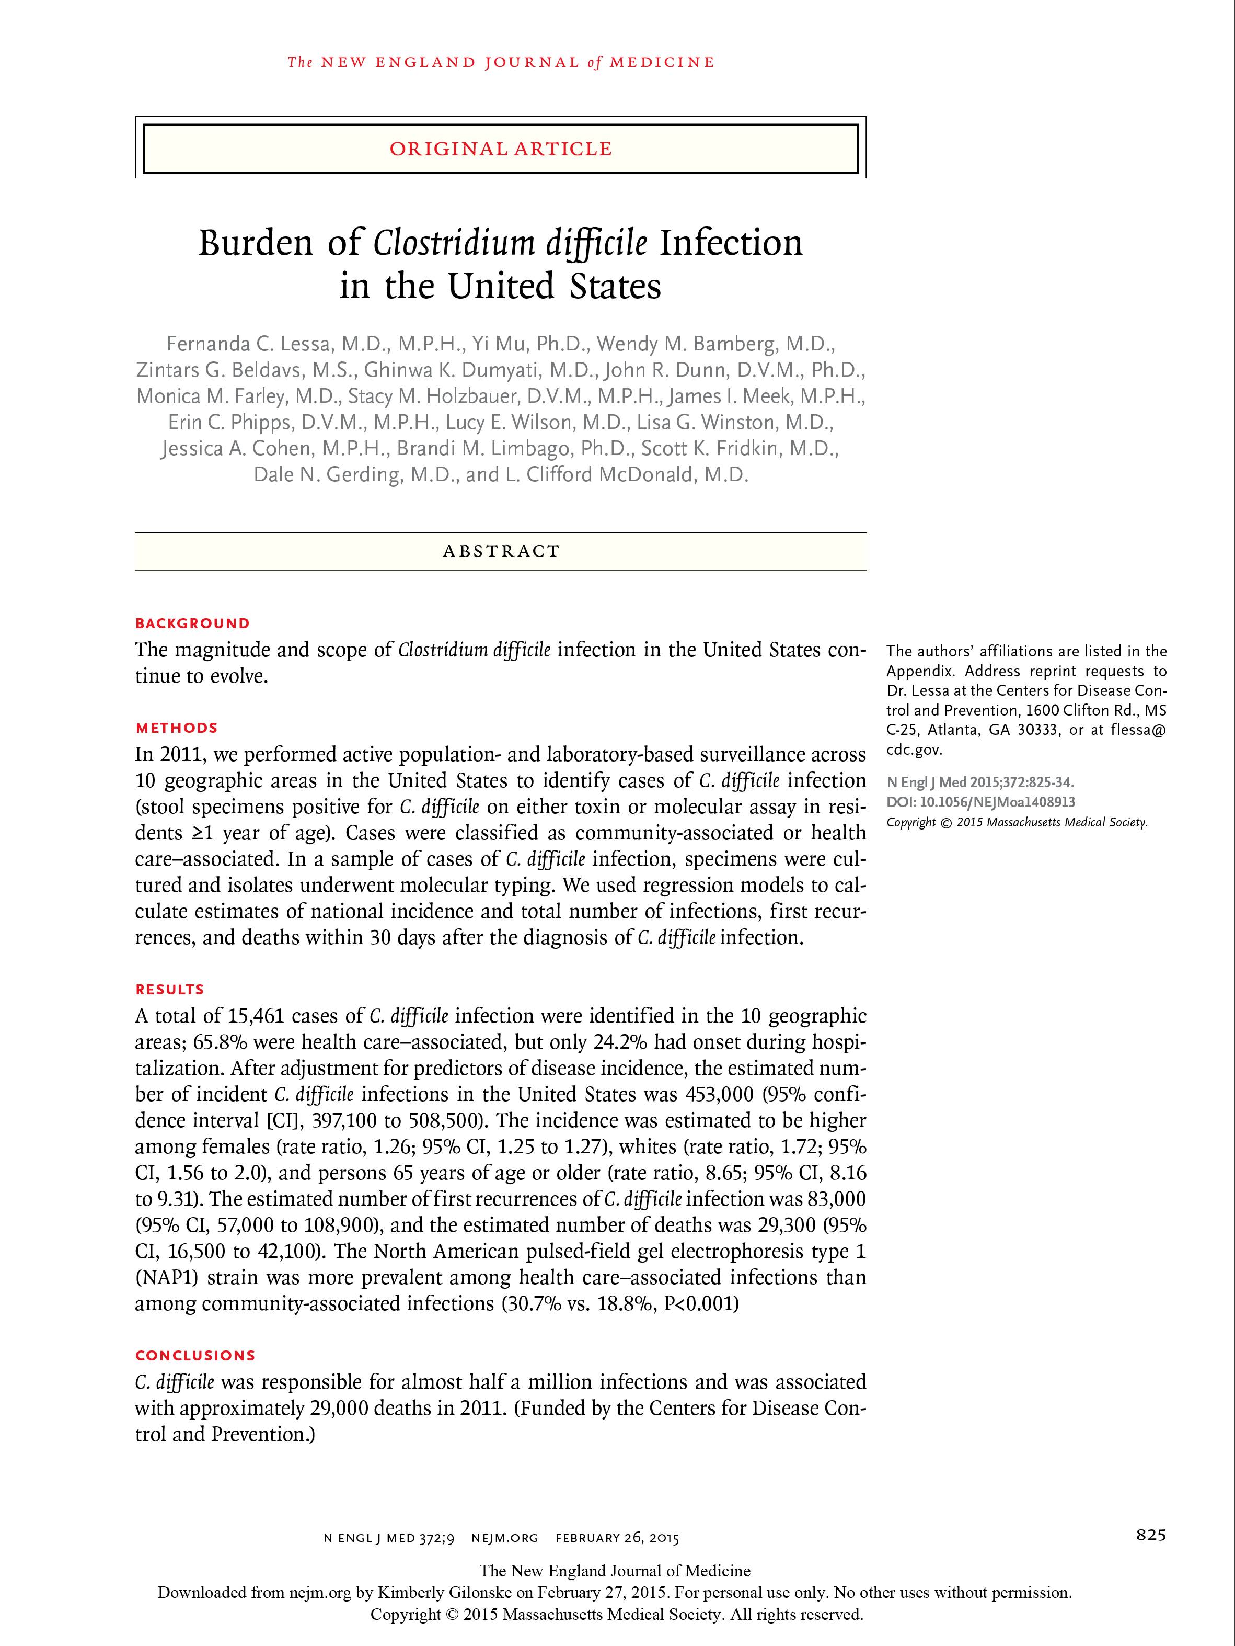
C. difficile Is Deadly
In February 2015, the CDC published a report in the New England Journal of Medicine indicating:
C. difficile was responsible for almost a half a million infections and was associated with ~29,000 deaths in the US in 2011
C. difficile infection (CDI) is the leading cause of gastroenteritis-associated death
The epidemic strain (ribotype 027) was the most common strain type, representing ~31% of healthcare-associated CDIs
http://www.nejm.org/doi/full/10.1056/NEJMoa1408913. Accessed August 31, 2016.
http://www.cdc.gov/media/dpk/2015/dpk-deadly-diarrhea.html. Accessed August 31, 2016.

Slide 3
Accurate and early identification of C. difficile infections is a crucial step for successfully treating patients and reducing severe outcomes and complications. In addition, a rapid diagnosis is also essential for implementing contact precautions and preventing transmission of the organism from patient to patient.”
Barbut F, et al. Does a rapid diagnosis of Clostridium difficile infection impact on quality of patient management? Clin Microbiol Infect. 2014;20:136-44.

Slide 4
The Challenge of C. difficile Diagnosis
Rapid and accurate diagnosis is essential for:
Implementation of appropriate therapy
Infection control and prevention of further transmission
Over diagnosing C. difficile can result in:
Unnecessary isolation or contact precautions that can increase cost and patient distress
Unnecessary antibiotic treatment and antibiotic-related adverse events
Underdiagnosing C. difficile can result in:
Delays in treatment and a poor clinical outcome
Disease transmission and associated infection-related costs and outcomes

Slide 5
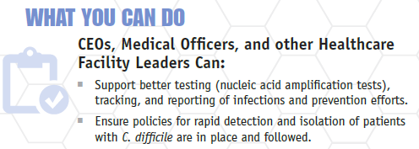
CDC Recommends Rapid Nucleic Acid Testing for Prompt Infection Control
http://www.cdc.gov/drugresistance/pdf/ar-threats-2013-508.pdf

Slide 6
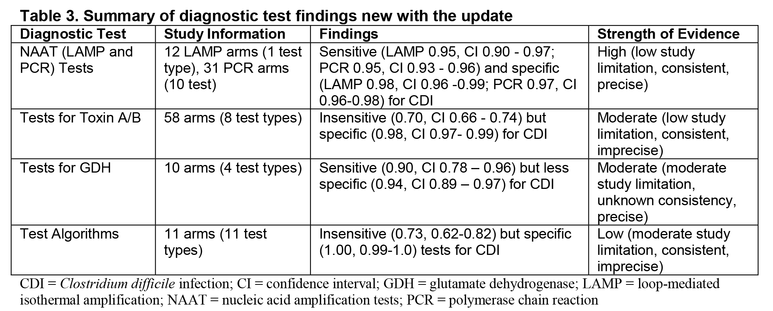
According to the Agency for Healthcare Research and Quality, Only NAAT-based Methods Are Both Sensitive and Specific
According to the 2016 AHRQ Comparative Effectiveness Review:
“We found moderate to high evidence that NAAT tests (one LAMP, 10 PCR) are highly sensitive and specific.”
“Test algorithms, intended to make the best of individual test strengths performed in series, did not perform as a class as well as NAAT tests.”
Butler M, et al. Comparative Effectiveness Review No. 172. AHRQ Publication No. 16-EHC012-EF. Rockville, MD: Agency for Healthcare Research and Quality; March 2016.

Slide 7
Are NAAT-based Assays Too Sensitive?
There is no perfect test to diagnose CDI¹
None of the available C. difficile testing methodologies can reliably differentiate colonization from infection¹
Because NAAT methods are more sensitive than other test methods, they can detect toxigenic C. difficile not only in infected patients, but also in patients who are colonized with the organism, especially if solid stools are tested¹
EIA-based toxin tests are less sensitive than NAAT-based tests and likely underdiagnose CDI, resulting in missed cases and worse outcomes¹
To control CDI in a hospital, you need the most sensitive test available¹
NAAT-based testing, in the context of clinical factors, is the only sensitive and specific method for diagnosing CDI²
Fang FC, Polage CR and Wilcox MH. J Clin Microbiol. doi:10.1128?JCM.02463-16.
Butler M, et al. Comparative Effectiveness Review No. 172. AHRQ Publication No. 16-EHC012-EF. Rockville, MD: Agency for Healthcare Research and Quality; March 2016.

Slide 8
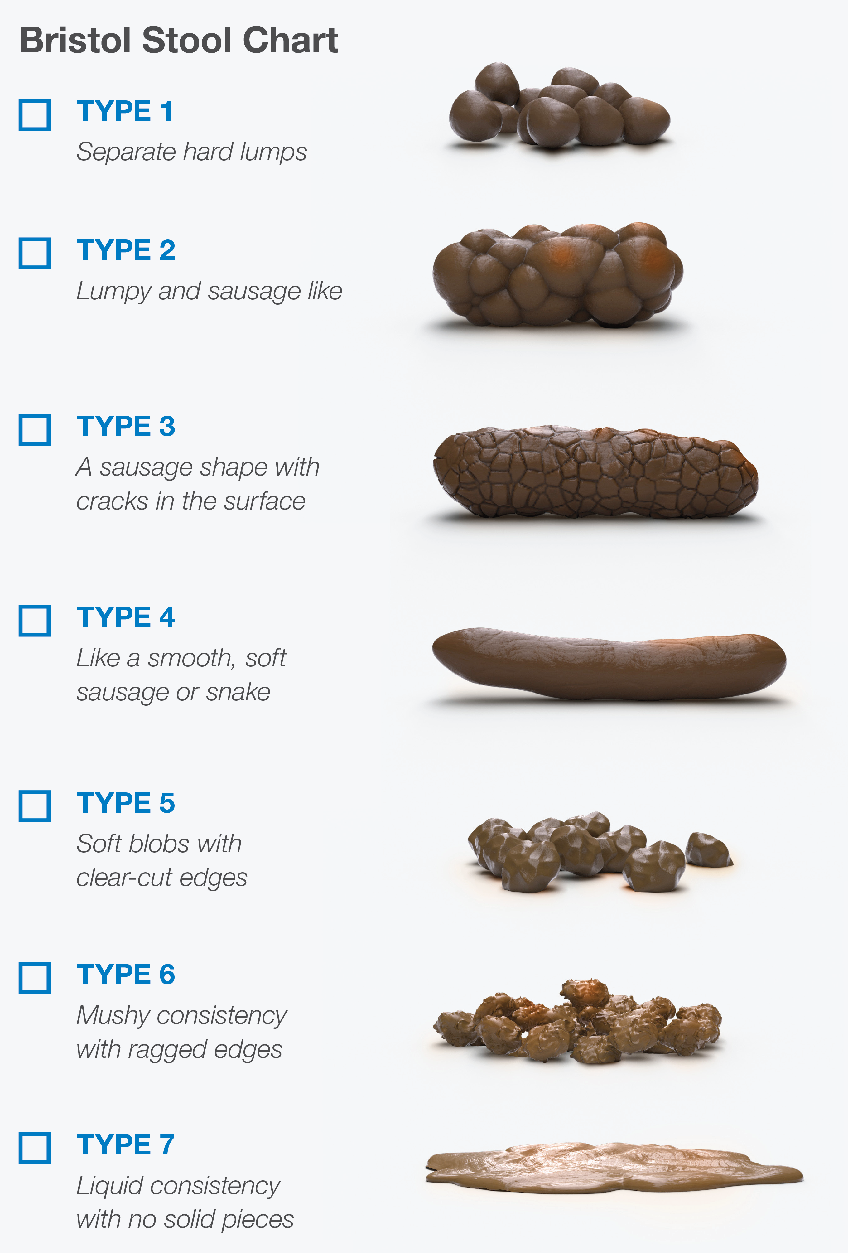
Diagnosis Should Not Be Based on Laboratory Tests Alone
To avoid over-diagnosing CDI:
Testing should be limited to unformed stools
Only test samples from patients with clinically significant diarrhea (3 or more loose stools in ≤ 24 hours)
Clinicians should consider the full clinical picture, including signs and symptoms as well as patient risk factors
Surawicz CM, Brandt LJ, Binion DG, et al. Am J Gastroenterol. 2013;108:478-98.
Cohen SH, Gerding DN, Johnson S, et al. Infect Control Hosp Epidemiol. 2010;31:431-55.

Slide 9
Impact of the Enforcement of C. difficile Testing Criteria on CDI Rates and Antibiotic Therapy
According to a study from Stanford (Truong et al, 2017), enforcement of testing criteria* using real-time electronic patient data tracking resulted in:
A decrease in reported HO-CDI incidence rate (an average of 13.0 cases to 9.7 cases per 10,000 patient-days; P=0.008)
A decrease in unnecessary antibiotic therapy (an average of 13.8 days oral vancomycin therapy to 9.4 days per 1000 patient-days; P= 0.009)
“The reduction in HO-CDI incidence achieved at our hospital by avoiding detection of colonized patients may be sufficient to avoid the Medicare reimbursement penalty and adoption of our intervention may assist other institutions seeking to reduce their HO-CDI rates.”
*Presence of diarrhea (≥3 unformed stools in 24 hours) and absence of laxative intake in the prior 48 hours
Truong CY, Gombar S, Wilson R, et al. J. Clin. Microbiol. 2017 doi:10.1128/JCM.02319-16
http://jcm.asm.org/content/early/2017/02/23/JCM.02319-16.full.pdf+html

Slide 10
WAIT & EVALUATE
Considerations Before Ordering a C. difficile Test
Does the patient have clinically significant diarrhea?
Are there other reasons for diarrhea?
Does the stool sample take the shape of the collection container?
Has the patient received laxatives or enteral feeding?
Repeat testing or testing for “cure” is discouraged

Slide 11
TAKE ACTION
Signs and Symptoms of C. difficile:
Diarrhea (3 or more watery or unformed stools within 24 hours)
Fever
Abdominal pain/tenderness
Elevated white blood cell count and creatinine levels
Decreased albumin
Additional risk factors include:
Exposure to antibiotics within last 90 days
Prior hospitalization
Advanced age
Use of proton-pump inhibitors

Slide 12
Timing Matters
Don’t delay!
Timely collection of appropriate stool samples from patients with signs and symptoms of C. difficile is important to accurately identify community-onset cases

Slide 13
Summary
Accurate and early identification of C. difficile infections is necessary for successful treatment and a reduction in severe outcomes and complications
Rapid detection of C. difficile is also essential for quickly implementing infection prevention interventions to limit the transmission of the organism from patient to patient
None of the available C. difficile testing methods can reliably differentiate colonization from infection
NAAT-based testing, in the context of clinical factors, is the only sensitive and specific method for diagnosing CDI
The diagnosis of CDI should not be based on laboratory findings alone
Limiting testing to unformed stool samples* from patients with clinically significant diarrhea and risk factors for CDI can help prevent the identification of patients who are colonized, but not infected
*Unless ileus due to C. difficile is suspected; Cohen SH, Gerding DN, Johnson S, et al. Infect Control Hosp Epidemiol. 2010;31:431-55.

